Slide 1
Sector Correlations
Tutorial

Slide 2
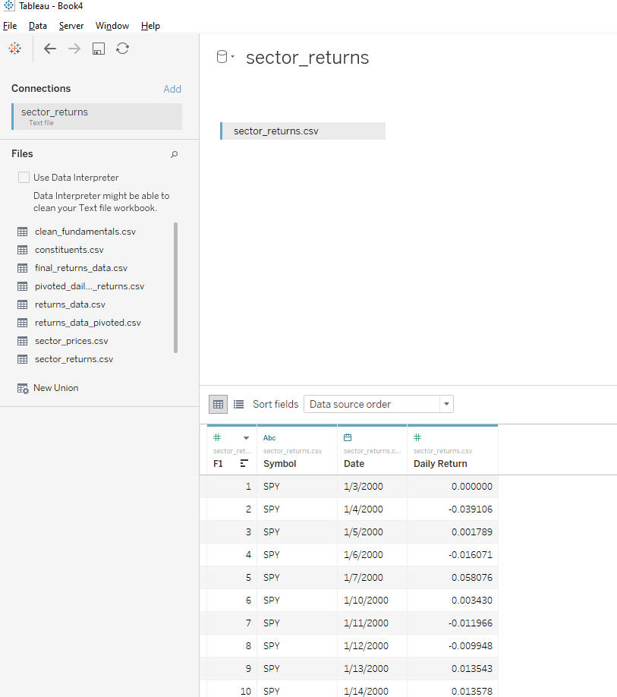
Connect to the data
Use the file Sector_returns.csv
This is a precomputed, long table of daily returns for all the sectors and the S&P 500
Hide the F1 columns like always

Slide 3
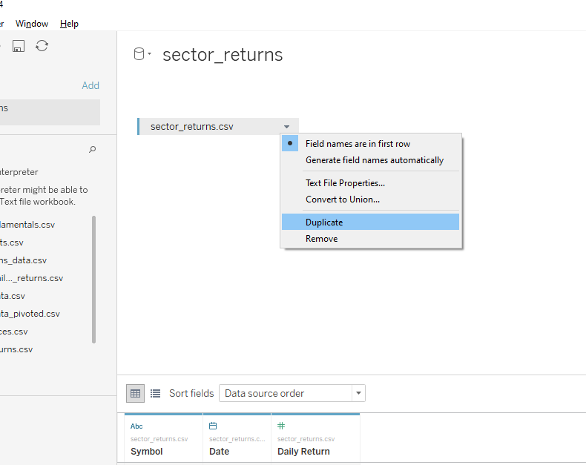
Duplicate the data
Duplicate sector_returns.csv by clicking the duplicate option

Slide 4
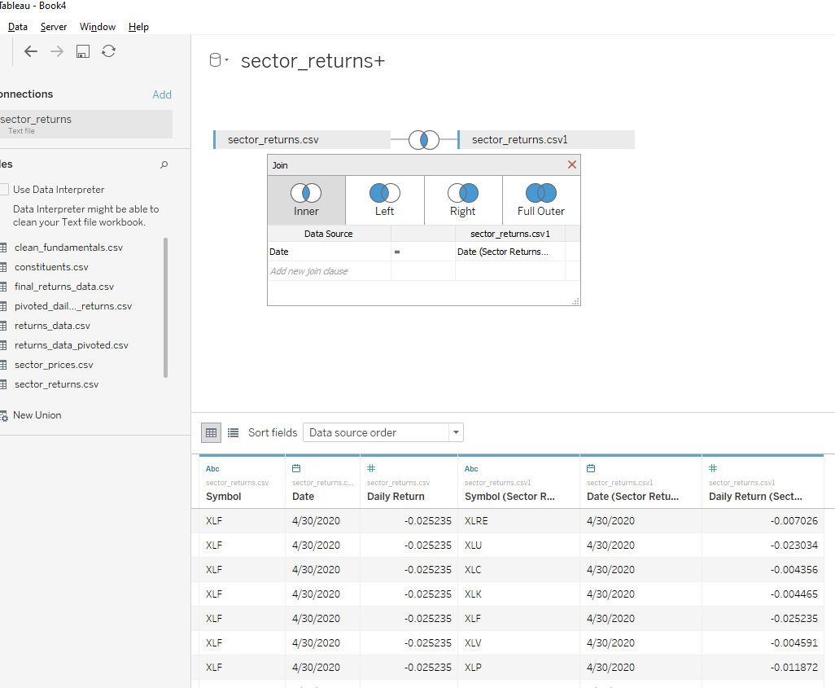
Inner Join on Dates
Setup the inner join between the two identical datasets by inner joining on dates
Hide the F1 column for the right hand dataset

Slide 5
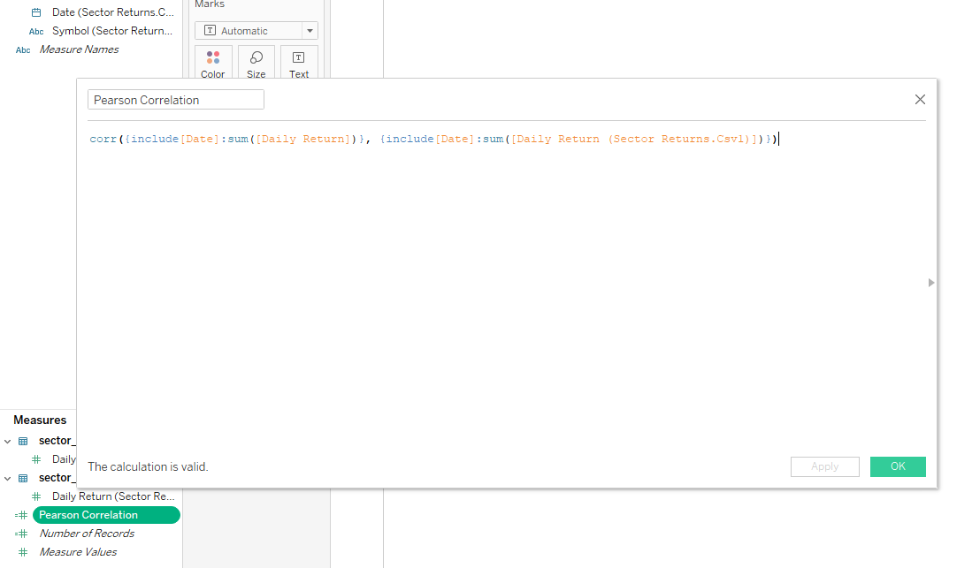
Correlation calculated field
Open a blank worksheet
Create a new calculated field
Enter the formula:

Slide 6
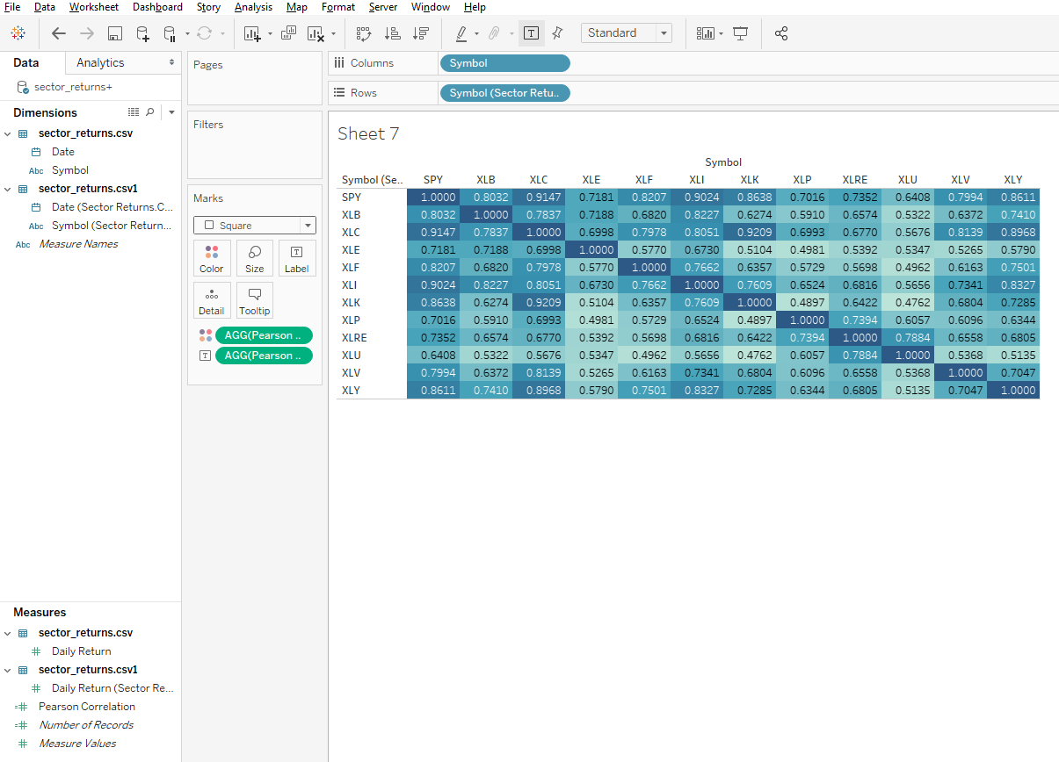
Correlation heat map
Add the columns, rows, and marks like so. Pay particular attention to the “Marks“ panel.
Name the worksheet “correlation heat map”

Slide 7
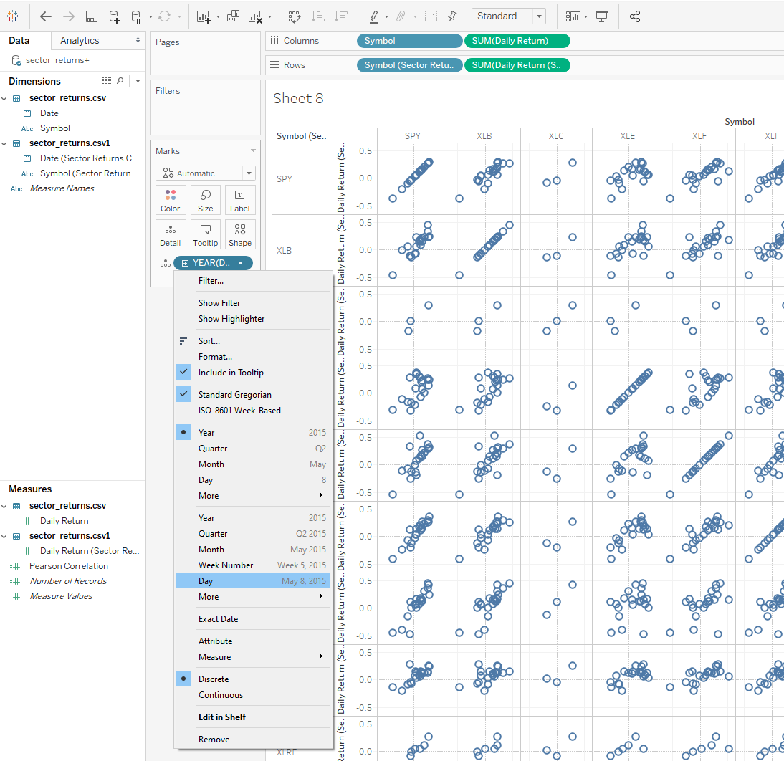
Correlation Scatter Matrix
Go to new worksheet
To create the scatter matrix, follow this sheet pattern:
Make sure to set the detail to the right day level
Name the worksheet “scattermatrix”

Slide 8
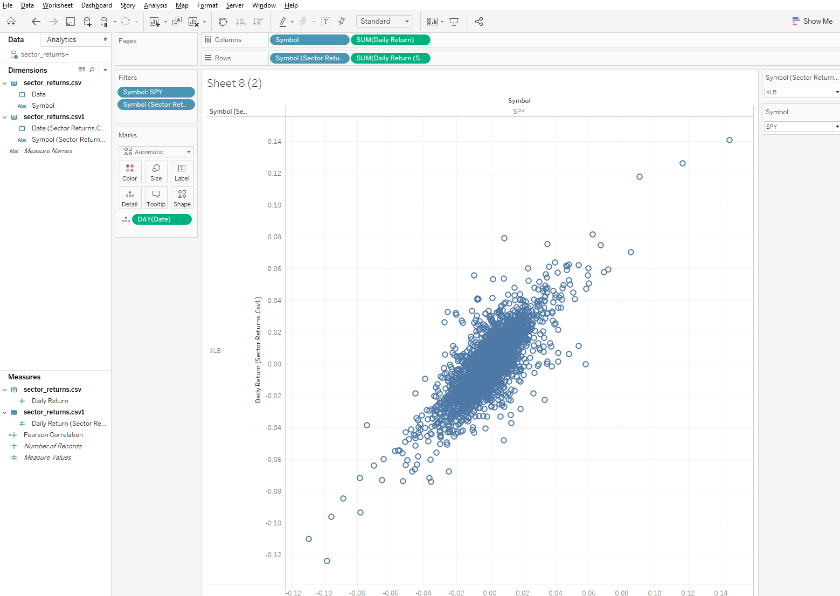
Individual scatters
Duplicate the “scattermatrix” worksheet
Add in the Symbol field from sector_returns.csv and sector_returns.csv1 into the filters pane
Show both filters
Change each filter to be single value dropdowns
It should look like:

Slide 9
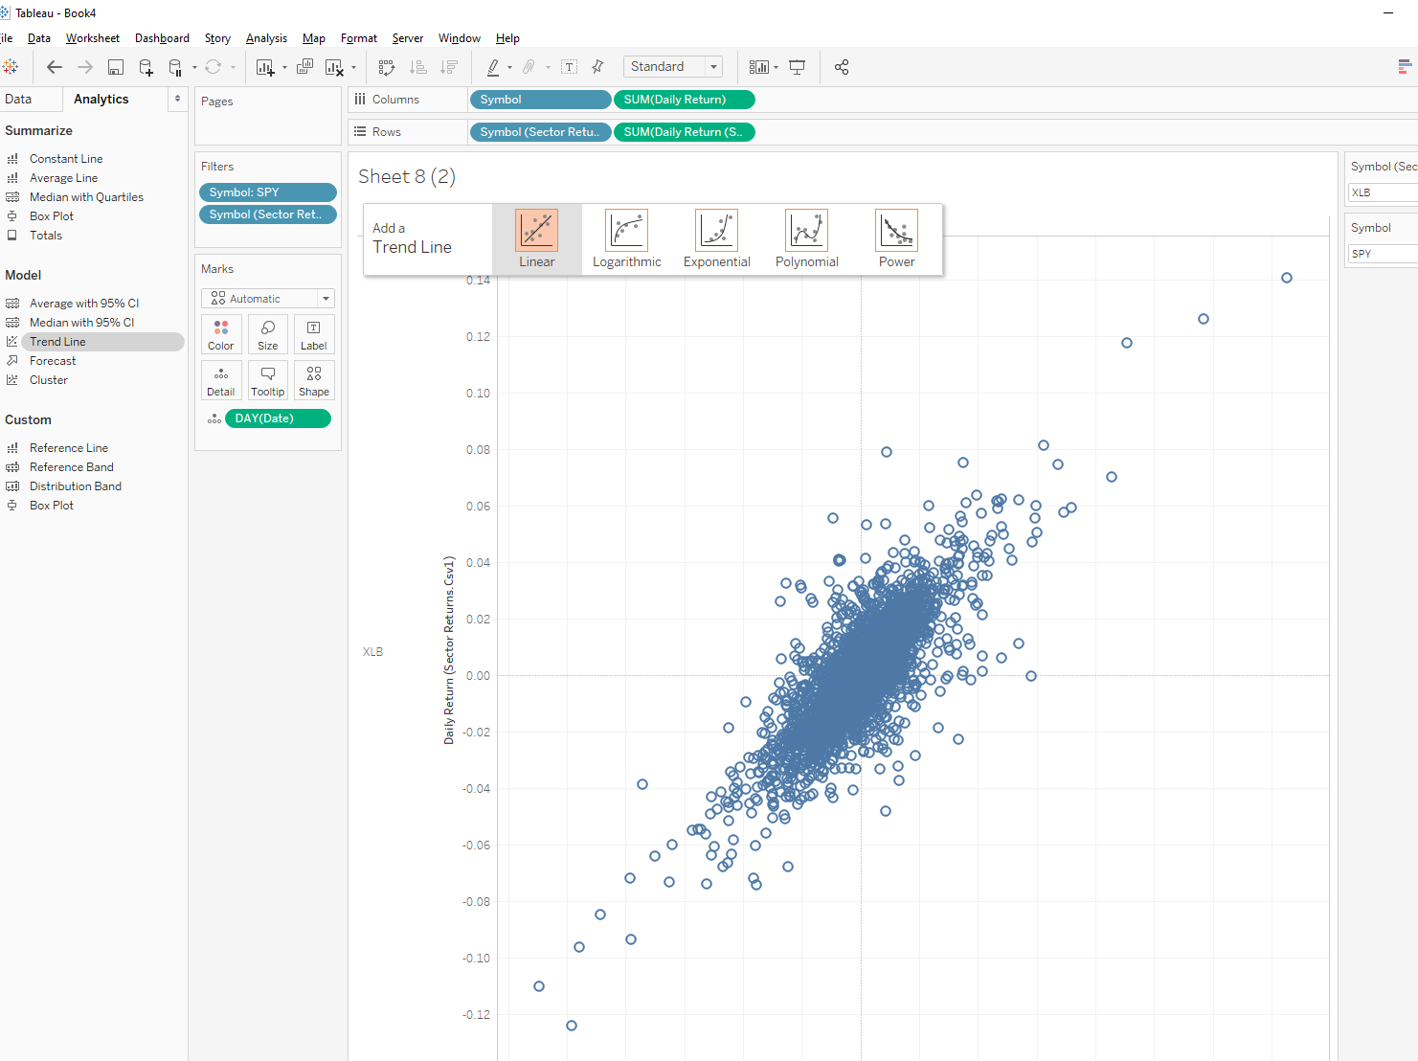
Adding a trend line
Click on the analytics tab on the left
Drag the trend line to the chart window and put the item on the linear trend like so:

Slide 10
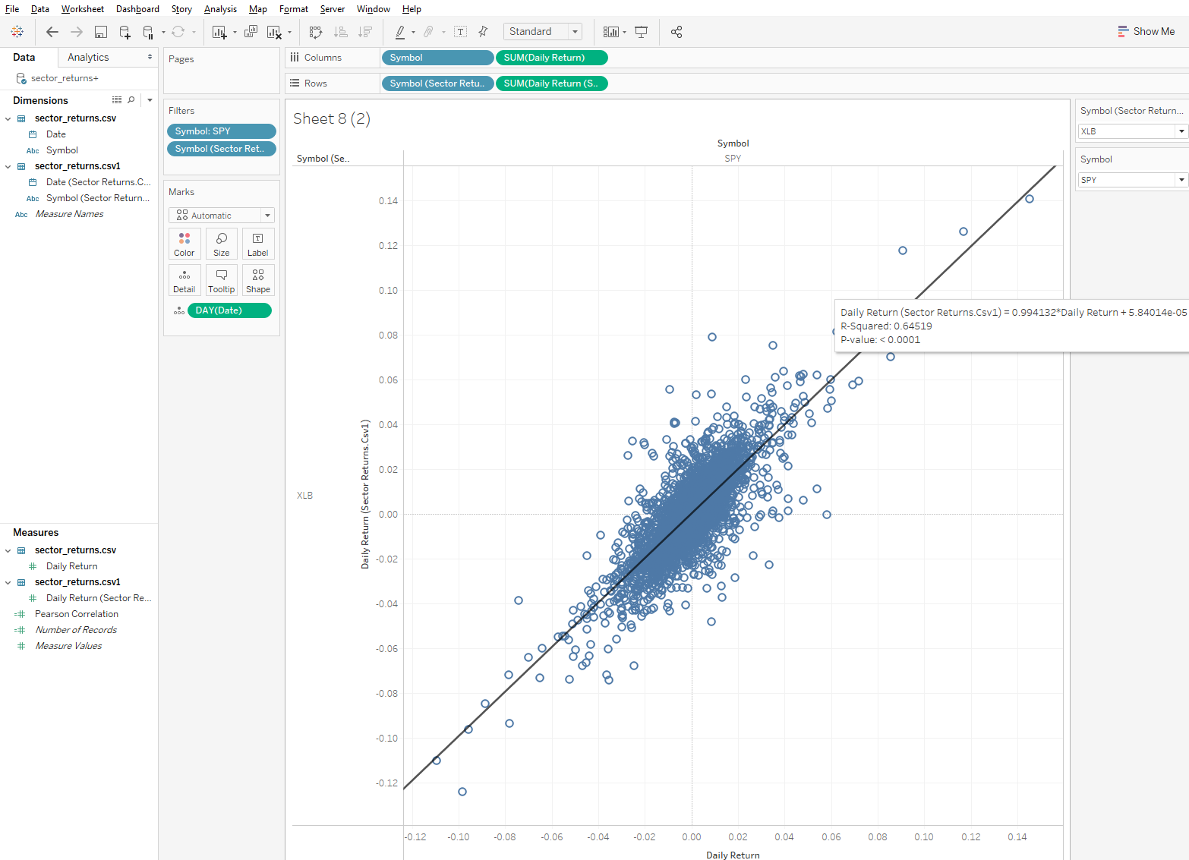
Dynamic scatter plot
Now you can quickly compare scatterplots between any two series in your dataset and view the statistics

Slide 11
Adding more filters
You can add and show a date filter on any of the worksheets
This will let you explore how the correlation changes between any of the sectors and the S&P 500 over time.

